Slide 1


Team 50: Remote Biometric System
Demo Simon Becker
Andrew-Joseph Nicolas
Lance Pagaduan
Harin Sankar Sponsor: Dr. Steven Wright TA: Hailey Ward

Slide 2
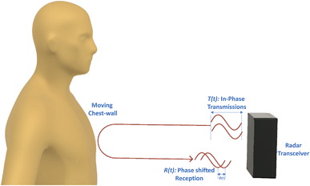
Contactless Cardiac Gating
Extensive and uncomfortable prep can be necessary
MRI Patient throughput can be improved
32% of patients think they wait too long for MRIs¹
Vasireddy, Rakesh & Roth, Corinne & Mathis, Johannes & Goette, Josef & Jacomet, Marcel & Vogt, Andreas. (2018). K-band Doppler radar for contact-less overnight sleep marker assessment: a pilot validation study. Journal of Clinical Monitoring and Computing. 32. 10.1007/s10877-017-0060-9.
Dostál, M., Jurasová, K., Keřkovský, M. et al. What factors affect a patient’s subjective perception of MRI examination. Sci Rep 14, 22731 (2024). https://doi.org/10.1038/s41598-024-74231-9
Notes:
Kyle

Slide 3
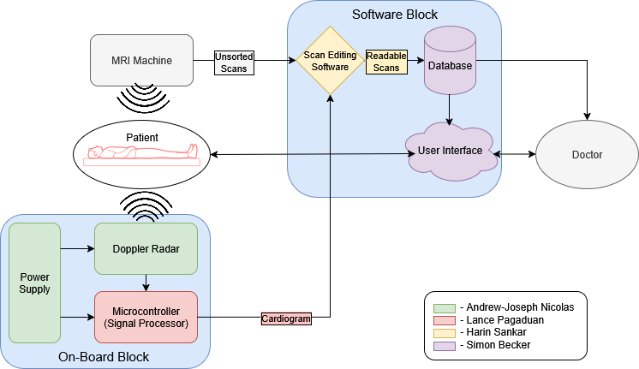
Contactless Cardiac Gating
Notes:
Eric

Slide 4
PCB Technical Merit
Designed and built a multi-rail power PCB, including component selection, schematic capture, layout, and assembly
Validated transient performance under dynamic loads, achieving <±100 mV deviation and 80–120 µs settling time
Verified stable system operation powering MCU and peripherals, with reliable UART communication and no resets under load
Implemented board functionality with all custom hardware and on-board MCU

Slide 5
PCB Demo Functionality
Probe all rails and confirm correct voltage
Showcase all hardware is powered
Discuss design choices and highlight key integration functionality with MCU

Slide 6
PCB Validation
Input Voltage Drop Analysis
Load Current (A) | Vin (No Load) (V) | Vin (With Load) (V) | ΔVin (mV) | % Drop
1 | 12.14 | 12.09 | 50 | 0.41%
2 | 12.14 | 12.03 | 110 | 0.91%
3 | 12.14 | 11.96 | 180 | 1.48%
Hardware Rails- Active:
Rail | Steady State (V) | Undershoot (mV) | Overshoot (mV) | Min Voltage (V) | Max Voltage (V) | Settling Time (µs) | Within Range?
5V, 3A (0.5A Step) | 4.96 | 21 | 20 | 4.939 | 4.98 | 80 | Yes
5V, 2A (0.5A Step) | 4.93 | 22 | 25 | 4.908 | 4.955 | 80 | Yes
5V, 3A (0.75A Step) | 4.96 | 32 | 40 | 4.928 | 5 | 95 | Yes
5V, 2A (0.75A Step) | 4.93 | 33 | 36 | 4.897 | 4.966 | 100 | Yes
5V, 3A (1A Step) | 4.96 | 95 | 105 | 4.865 | 5.065 | 115 | Yes
5V, 2A (1A Step) | 4.93 | 87 | 96 | 4.843 | 5.026 | 120 | Yes

Slide 7
PCB Validation
MCU Rail- Active:
Rail | Steady State (V) | Load Step (A) | Undershoot (mV) | Overshoot (mV) | Min Voltage (V) | Max Voltage (V) | Within Range?
3.3V, 0.5A | 3.38 | 0.05 | 7 | 10 | 3.373 | 3.39 | Yes
MCU Validation:
Test Category | Test Description | Expected Result | Measured Result | Status
Power | MCU supply voltage | 3.3 V | 3.28 V | Pass
Startup | MCU boots after power-on | Successful boot | Boots reliably | Pass
Clock | MCU clock operation | Stable frequency | Stable | Pass
UART TX | MCU transmits data | Data visible on PC | Verified (echo/data) | Pass
UART RX | MCU receives data | Correct calculations received | Verified | Pass
Reset | NRST functionality | MCU resets properly | Verified | Pass
Stability | Continuous operation | No crashes/reset | Stable over test | Pass

Slide 8
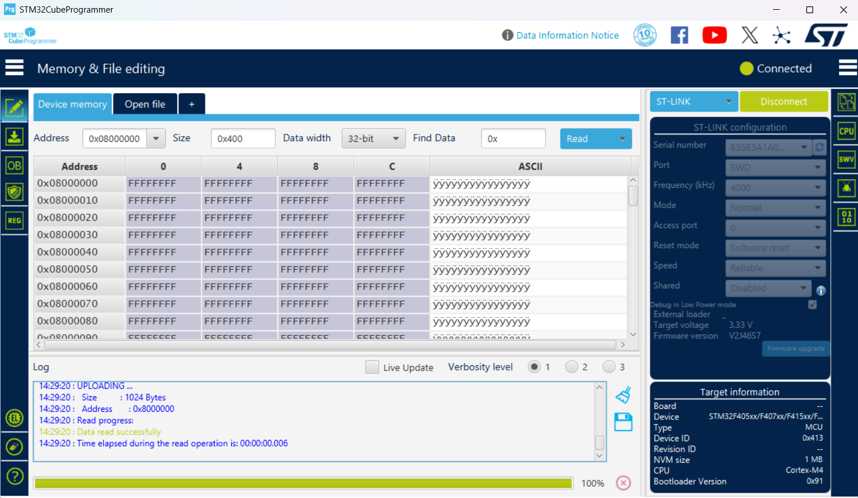
PCB Validation
STM32 can be communicated with:

Slide 9
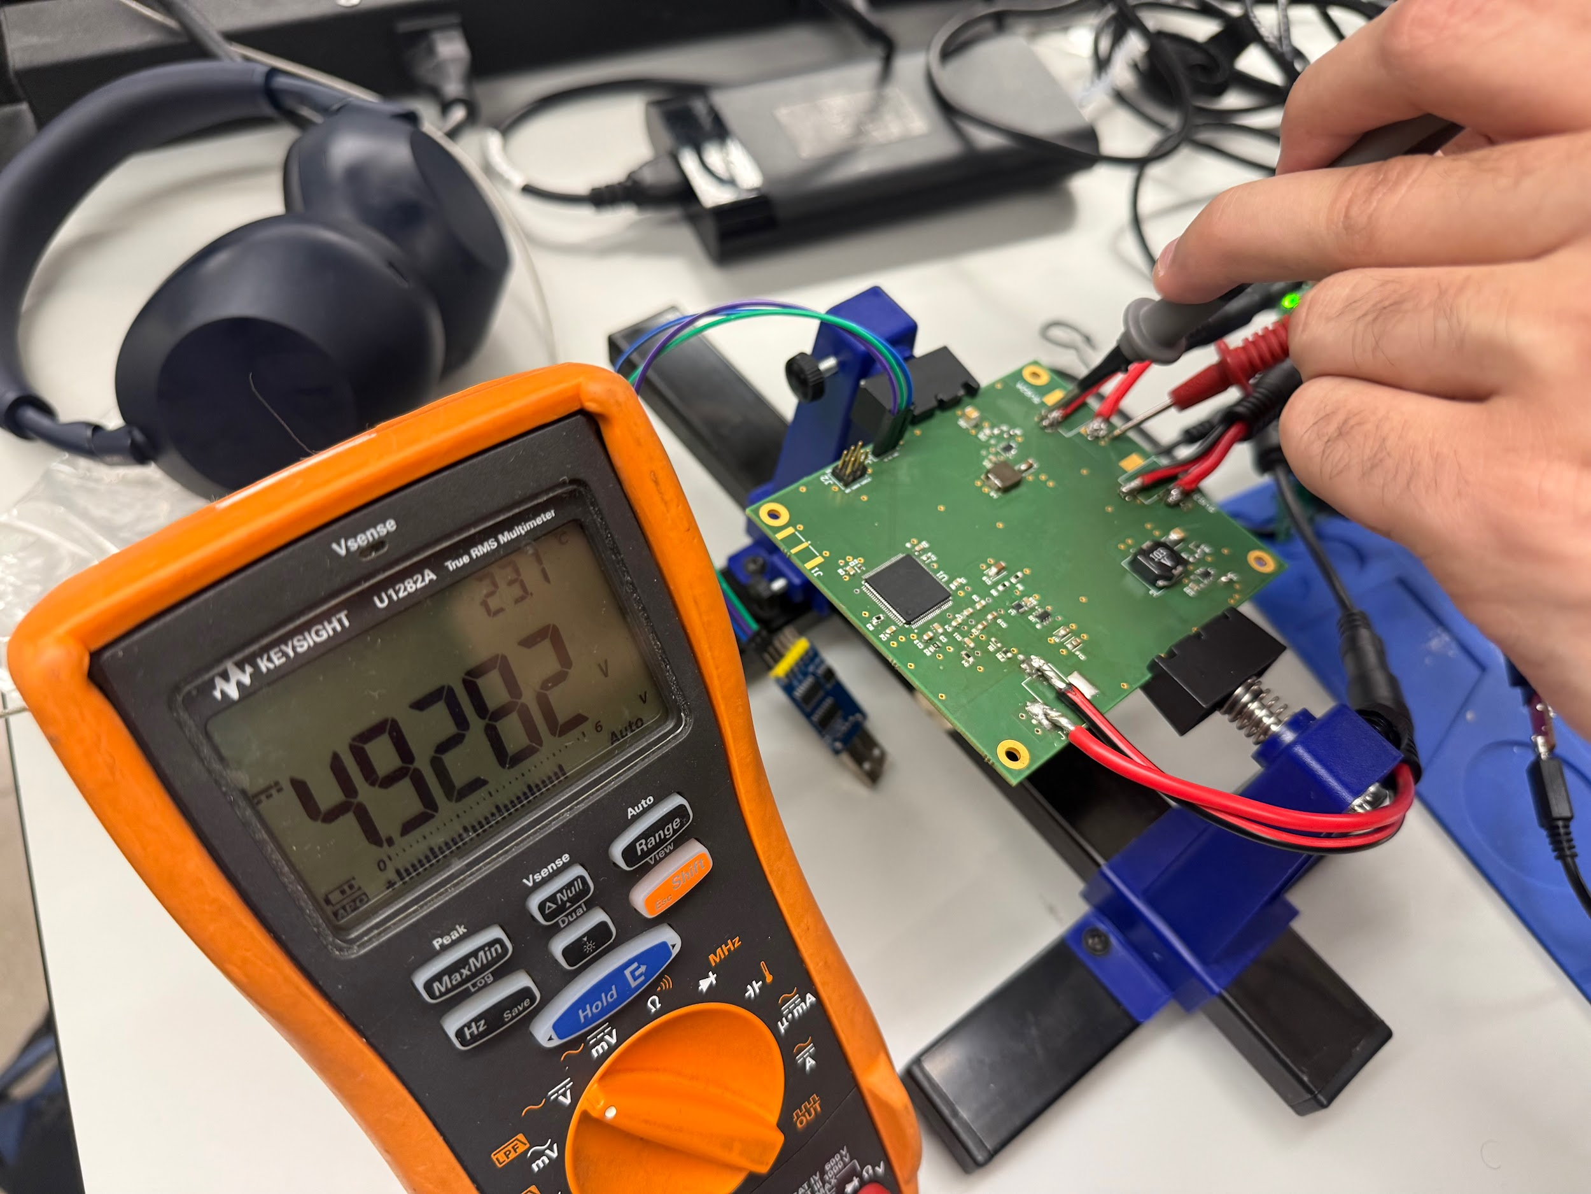
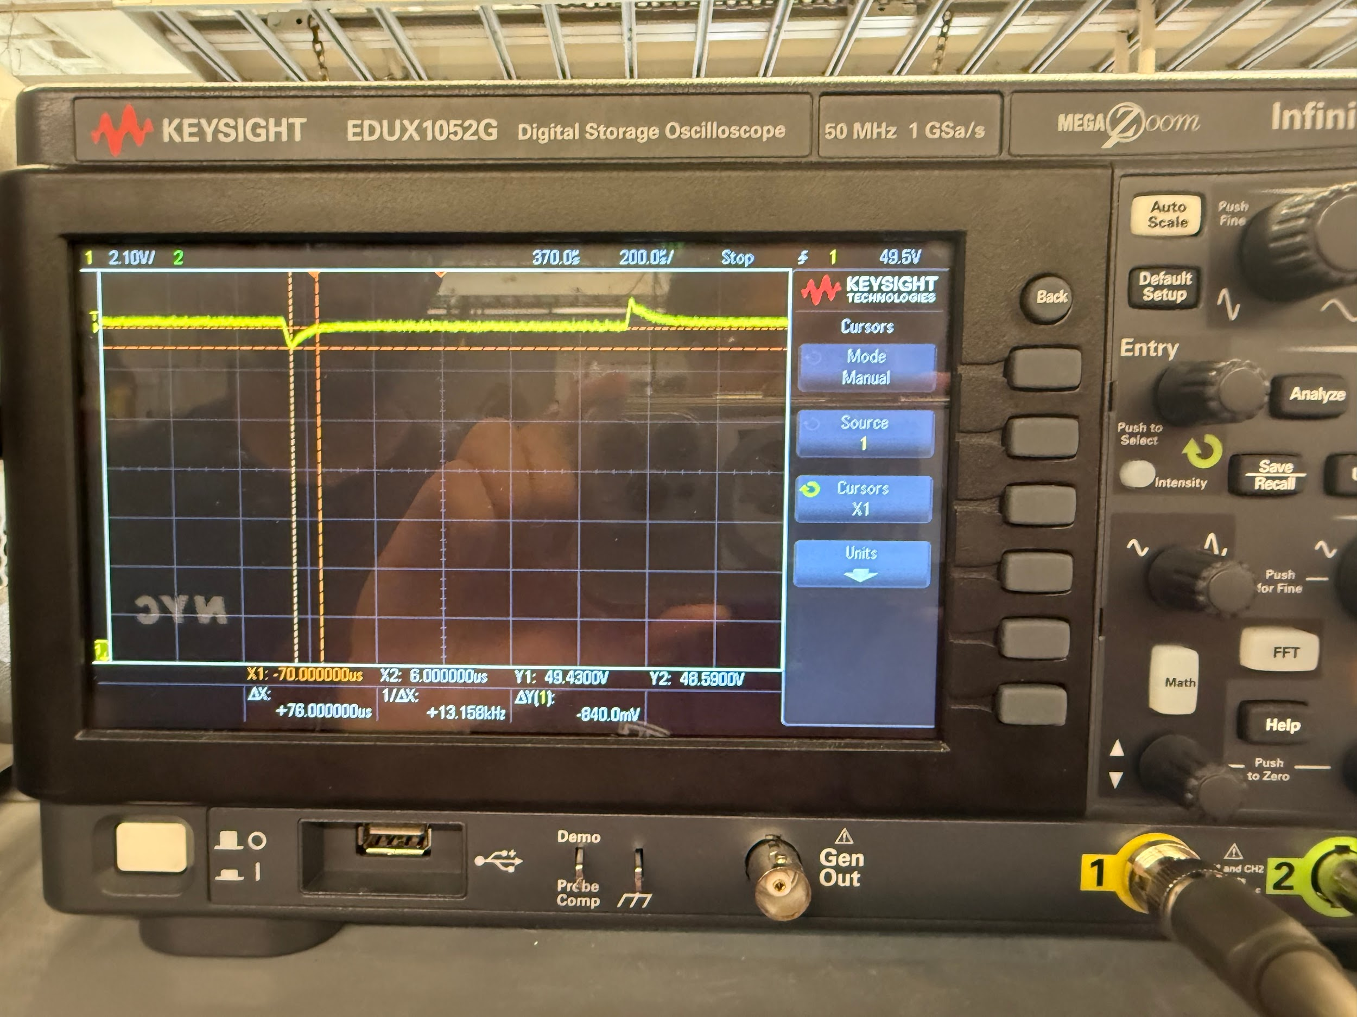
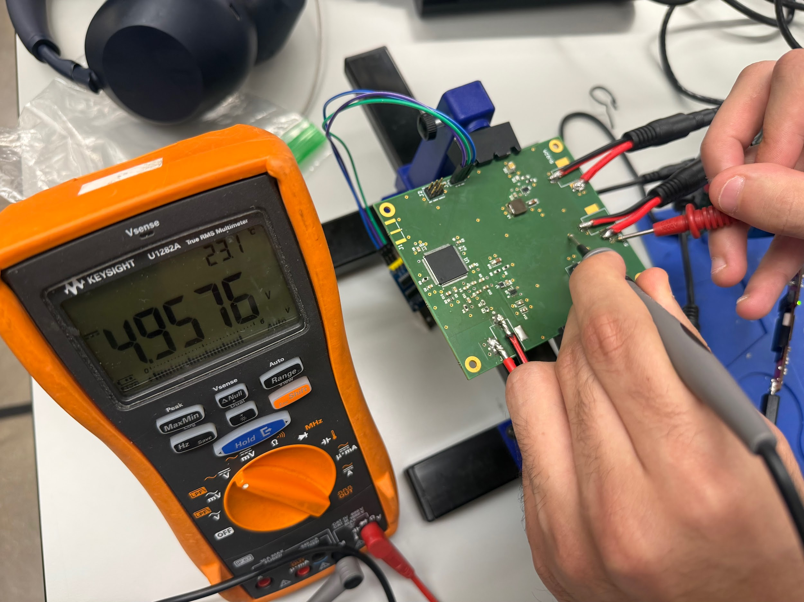
PCB Validation
(Example Photos)

Slide 10
Radar/MCU Technical Merit
Fully configured radar to extract IQ samples within a 0.2m-0.5m range
Coded MCU to be synchronous with MATLAB over UART in calculating vital signs and generating cardiogram data
Full integration with PCB to communicate over UART pins & generate a clean output clean cardiogram for scan editing

Slide 11
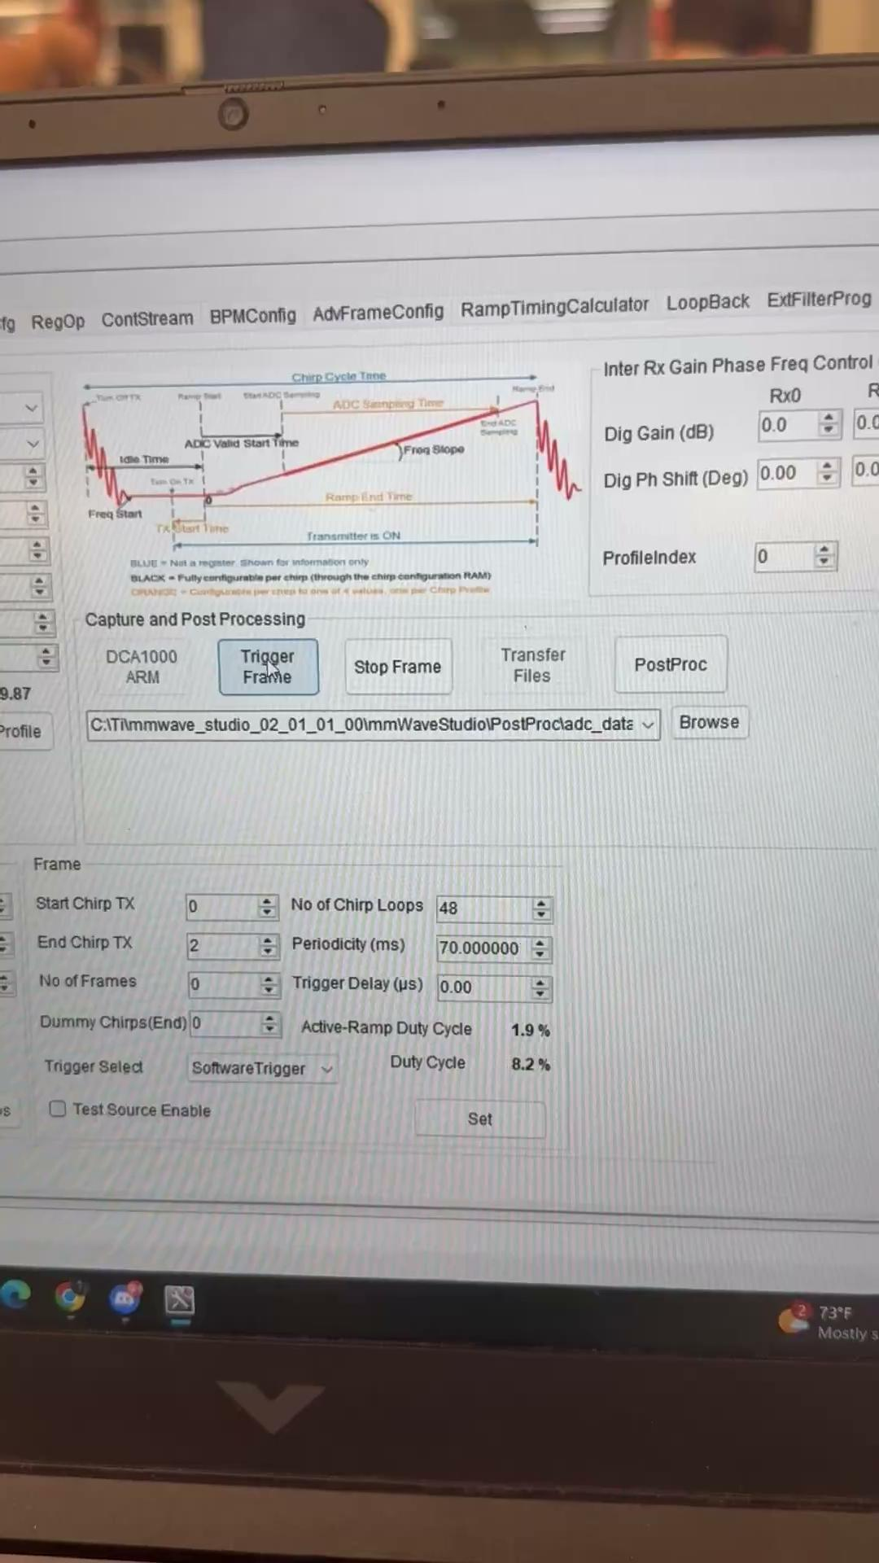
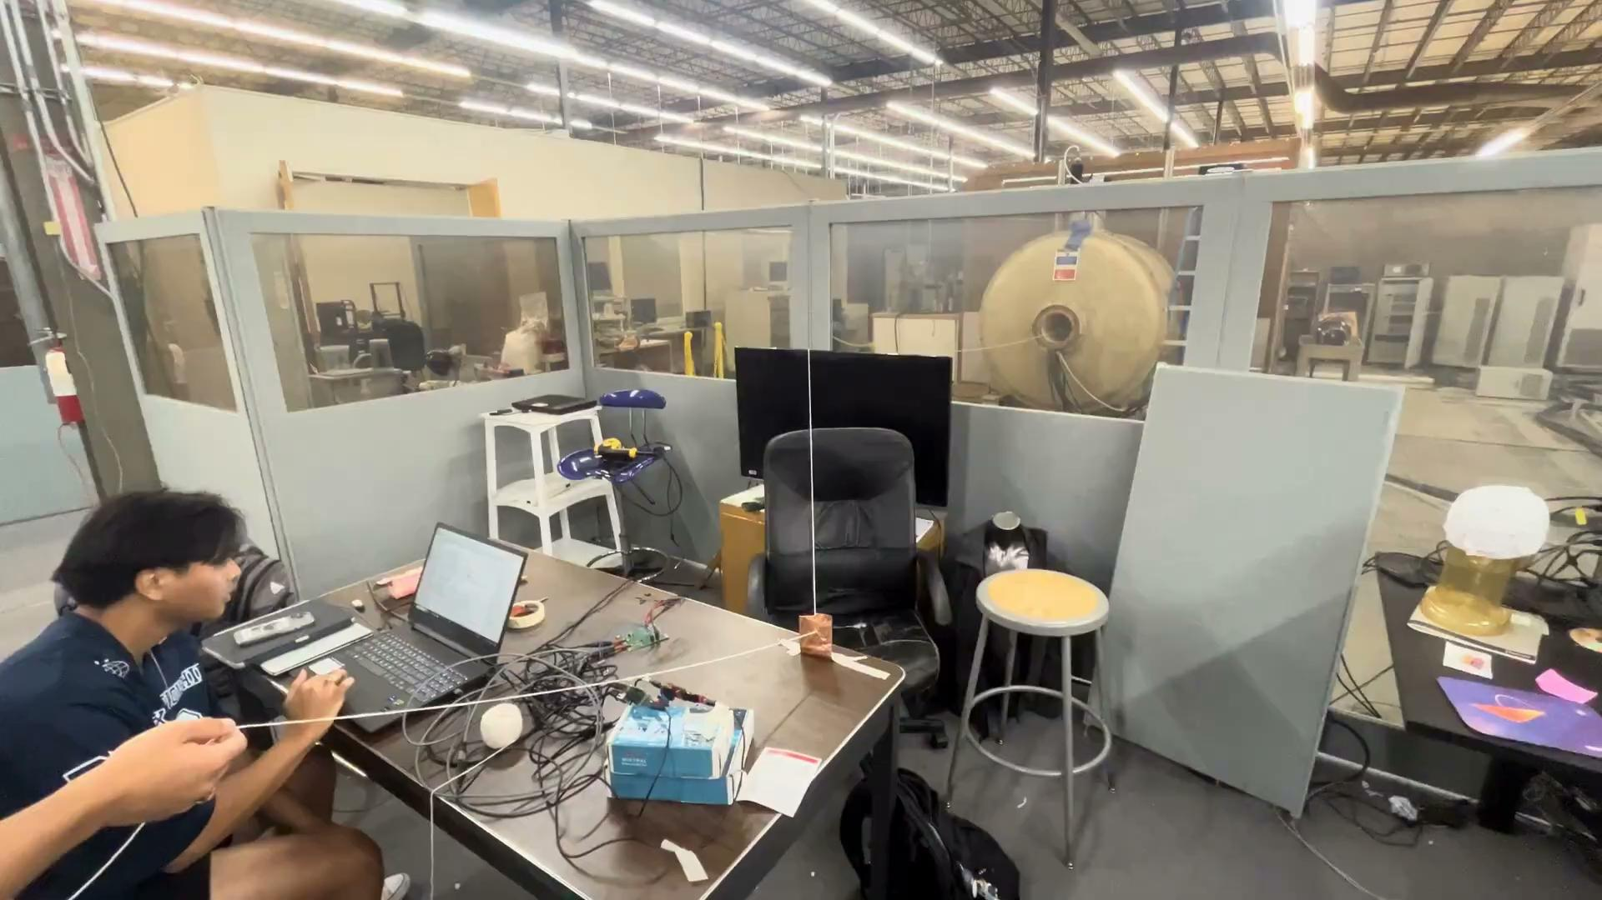
Radar/MCU Demo Functionality
Live Testing Gating Demo
Cardiac Gating Demo

Slide 12
Radar/MCU Validation
Data capture card reading files in
IQ Data removes DC offset to center data for cleaner calculation of vital signs
Chest is within measured range of radar
Trigger count is greater than 3 cycles and does not falsely activate

Slide 13
Scan Filter Technical Merit
Built a MRI gating pipeline for raw scan and waveform data.
Scored motion over time to find calmer acquisition windows.
Replaced corrupted scan lines across multiple scans to form a gated result.
Reconstructed images from k-space with FFT-based processing and exported PNG/DICOM output.
Created live and premade test cases to validate the full system

Slide 14
Scan Filter Demo Functionality
Cardiac Gating Demo
Live Test Gating Demo

Slide 15
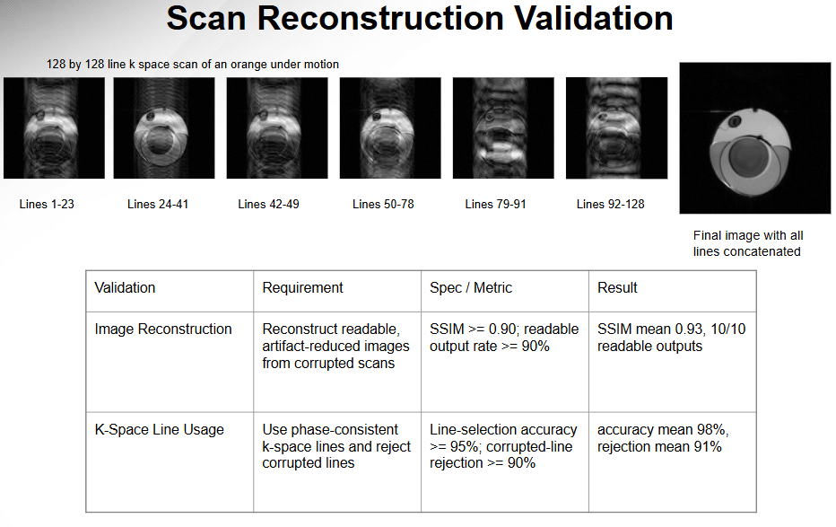

Slide 16
User Interface Technical Merit
Engineering Challenges:
HIPAA Compliance
Integrating Harin’s Scan Filter with the existing Desktop Application
Building a desktop application, SQLite database, accessing via webpage

Slide 17
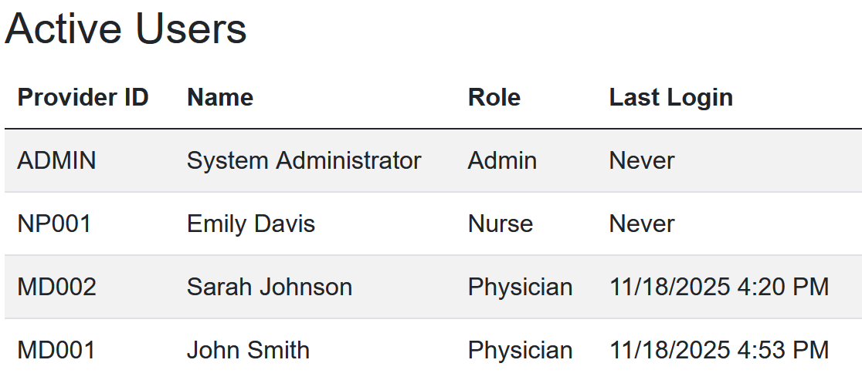

Slide 18
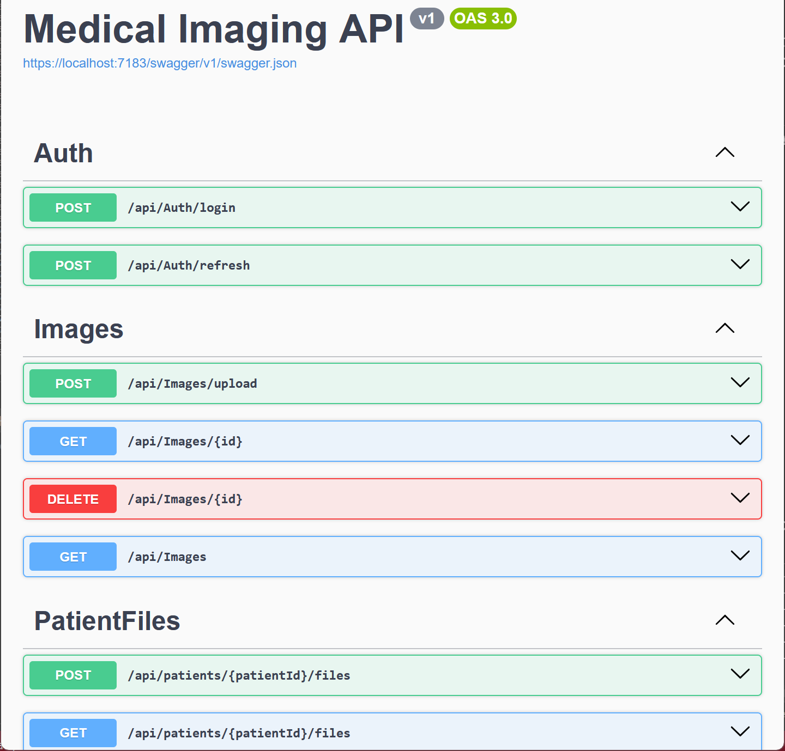

Slide 19
User Interface Validation
AES-256 encryption
16-bit password hashing
Forgot password functionality
Provider identity
SQLite database audit logging and storage

